Slide 1
COMPOUND INTEREST AND PRESENT VALUE

Slide 2
COMPOUND INTEREST (FUTURE VALUE)
Compounding –
Involves the calculation of interest periodically over the life of the loan or investment
Compound Interest –
The interest on the principal plus the interest of prior periods
Future Value (compound amount) –
The final amount of the loan or investment at the end of the last period
Present Value –
The value of a loan or investment today

Slide 3
COMPOUNDING TERMS
Compounding Periods Interest Calculated
Compounding Annually
Compounding Semiannually
Compounding Quarterly
Compounding Monthly
Compounding Weekly
Compounding Daily
1 time a year
2 times each year
4 times each year
12 times each year
52 times each year
365 times each year

Slide 4
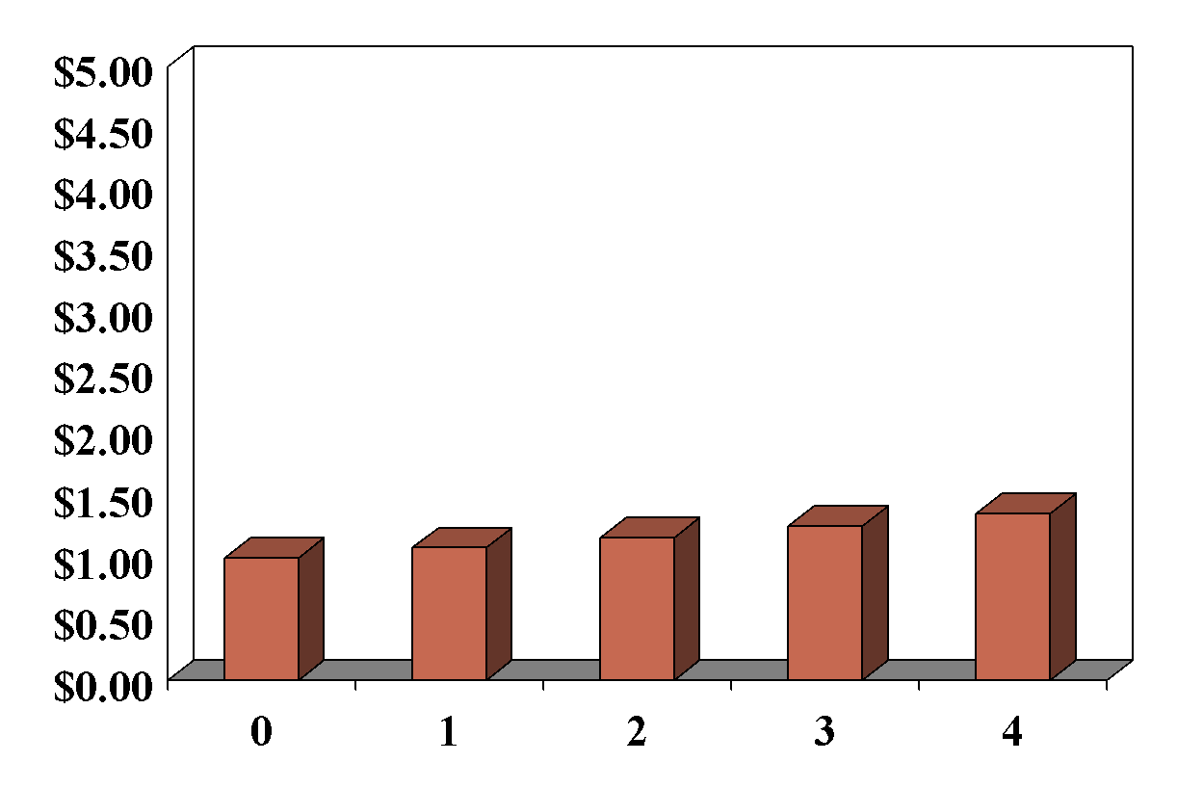
FUTURE VALUE OF $1 AT 8% FOR FOUR PERIODS
Compounding goes from present value to future value
Future Value
After 4 periods, $1 is worth $1.36
After 1 period, $1 is worth $1.08
After 2 periods, $1 is worth $1.17
After 3 periods, $1 is worth $1.26
Present
value
$1.00
$1.08
$1.1664
$1.2597
$1.3605
Number of periods

Slide 5
TOOLS FOR CALCULATING COMPOUND INTEREST
Number of periods (N) Number of years multiplied by the number of times the interest is compounded per year
Rate for each period (I)
Annual interest rate divided by the number of times the interest is compounded per year
If you compounded $1 for 4 years at 8% annually,
semiannually, or quarterly, what is N and I?
Periods
Rate
Annually:
Semiannually:
Quarterly:
4 × 1 = 4
Annually:
Semiannually:
Quarterly:
8% ÷ 1 = 8%
4 × 2 = 8
8% ÷ 2 = 4%
4 × 4 = 16
8% ÷ 4 = 2%

Slide 6
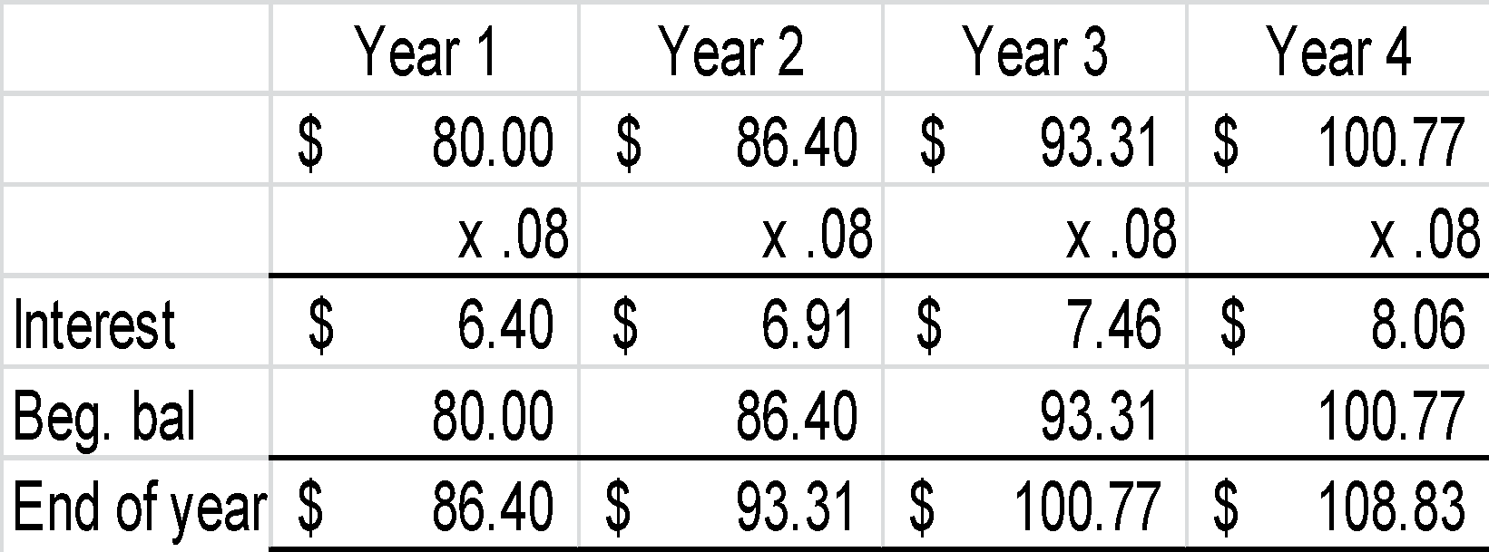
SIMPLE VERSUS COMPOUND INTEREST
Simple
Compounded
Bill Smith deposited $80 in a savings account for 4 years at an annual interest rate of 8%. What is Bill’s simple interest and maturity value?
Bill Smith deposited $80 in a savings account for 4 years at an annual interest rate of 8%. What is Bill’s interest and compounded amount?
I = P × R × T
I = $80 × .08 × 4
I = $25.60
MV = $80 + $25.60
MV = $105.60
Interest: $108.83 − $80.00 = $28.83

Slide 7
CALCULATING COMPOUND AMOUNT USING FORMULA
Step 1. Find the periods n: Years multiplied by number of times interest is compounded in 1 year.
Step 2. Find the rate i: Annual rate divided by number of times interest is compounded in 1 year.
Step 3. Plug the PV amount, n, and i into the following formula: FV = PV(1 + i)^{n}
Step 4. Solve. This gives the compound amount.

Slide 8
CALCULATING COMPOUND AMOUNT USING THE COMPOUND INTEREST FORMULA
Bill wants to know the value of $80 in 4 years at 8%. He begins by identifying the PV, n, and i:
PV = $80
n = 4 (4 years × 1 compounding period per year)
i = 8% (8% divided by 1 compounding period)
Calculator keystrokes for this problem are:
(1 + .08) y^{x} 4 × 80 = $108.84

Slide 9
CALCULATING COMPOUND AMOUNT using a financial calculator
Remember to clear the TVM each time you work with new data: 2ND CLR TVM
To solve the future value of $80 at 8% compounded annually for 4 years, using your calculator, follow these steps:
Step 1: Input 4 and then press N.
Step 2: Input 8 and then press I/Y.
Step 3: Input 80, press +/- and then press PV.
Step 4: Input 0, and then press PMT.
Step 5: Press CPT FV = 108.84

Slide 10
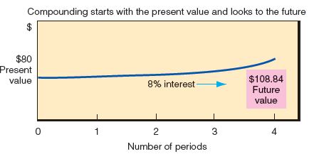
COMPOUNDING (FV)

Slide 11
CALCULATING THE COMPOUND INTEREST
FV – PV = Compound interest
$108.84 − $80.00 = $28.84

Slide 12
PROBLEM 1
Lynn Ally, owner of a local Subway shop, loaned $40,000 to Pete Hall to help him open a Subway franchise. Pete plans to repay Lynn at the end of 8 years with 6% interest compounded semiannually. How much will Lynn receive at the end of 8 years? LU 19-1(2)
Solution:
6%
2
$40,000 × (1 = .03)¹⁶ = $64,188.26
8 years × 2 = 16 periods
= 3%
Step 1: Input 16 and then press N.
Step 2: Input 6/2 = and then press I/Y.
Step 3: Input 40,000 +/- and then press PV.
Step 4: Input 0 and then press PMT.
Step 5: Press CPT FV = 64,188.26.

Slide 13
PROBLEM 2
Melvin Indecision has difficulty deciding whether to put his savings in Mystic Bank or Four Rivers Bank. Mystic offers 10% interest compounded semiannually. Four Rivers offers 8% interest compounded quarterly. Melvin has $10,000
to invest. He expects to withdraw the money at the end of 4 years. Which bank gives Melvin the better deal? Check your answer. LU 19-1(2)
Solution:
Mystic
4 years × 2 = 8 periods
Four Rivers
4 years × 4 = 16 periods
10%
2
8%
4
= 5%
= 2%
FV = $10,000(1 + .05)⁸ = $14,774.55
$14,774.55 − $10,000 = $4,774.55
FV = $10,000(1 +.02)¹⁶ = $13,727.86
$13,727.86 − $10,000 = $3727.86

Slide 14
PROBLEM 3
Lee Holmes deposited $15,000 in a new savings account at 9% interest compounded semiannually. At the beginning of year 4, Lee deposits an additional $40,000 at 9% interest compounded semiannually. At the end of 6 years, what is the balance in Lee’s account? LU 19-1(2)
Solution:
3 years × 2 = 6 periods
9%
2
= 4.5%
$15,000(1 + .045)⁶ = $19,533.90
+ 40,000.00
$ 59,533.90
$59,533.90(1 + .045)⁶ = $77,528.62

